Slide 1
Travel

Slide 2
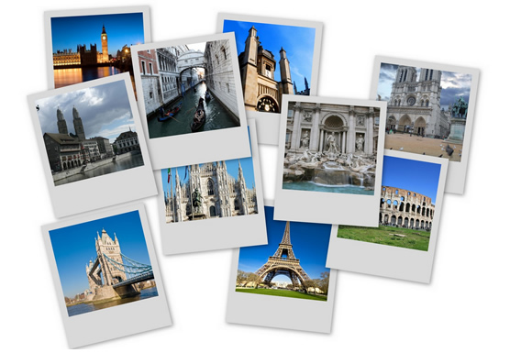
Trip
Tour
Journey
Sightseeing
Excursion

Slide 3
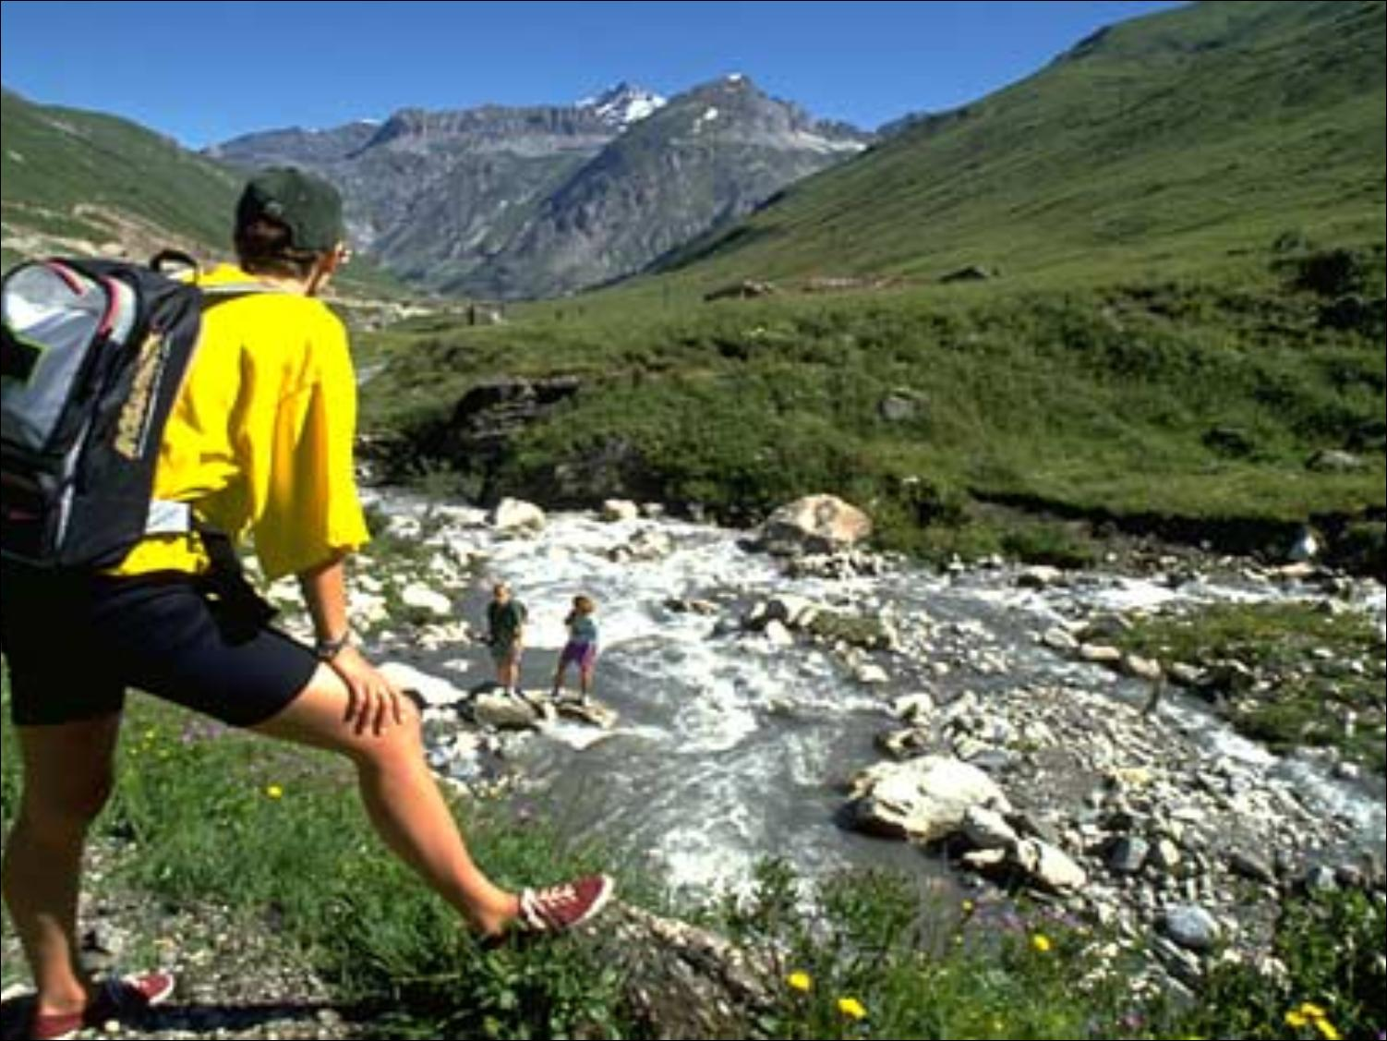
Hiking

Slide 4
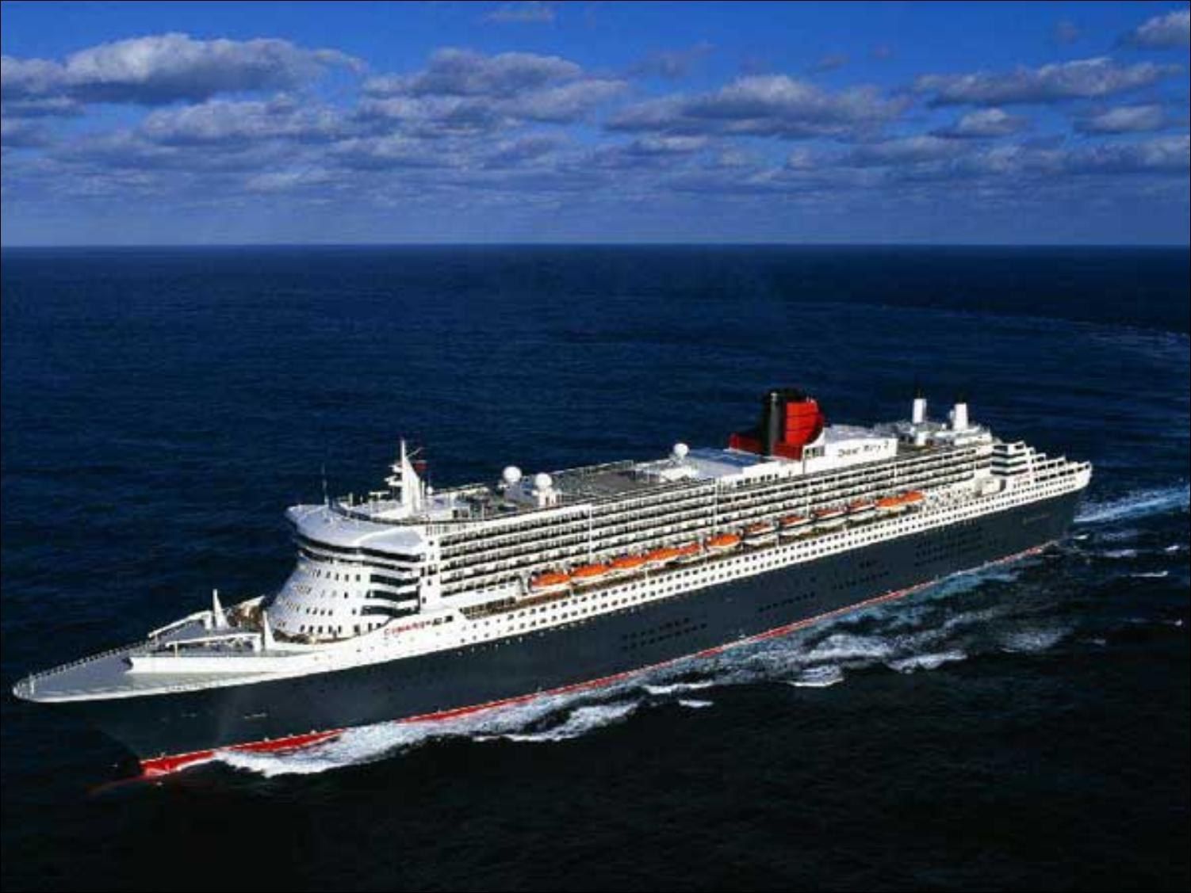
Cruise

Slide 5
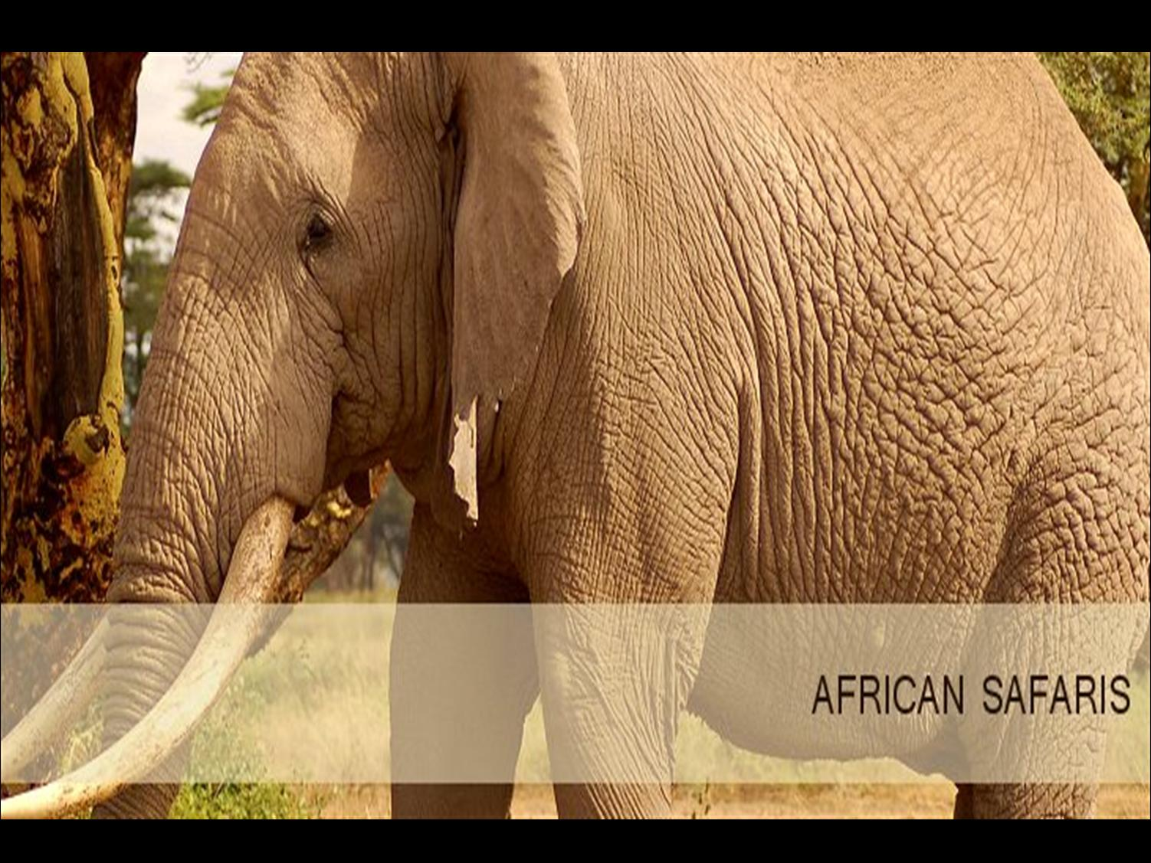
Safari

Slide 6


Slide 7
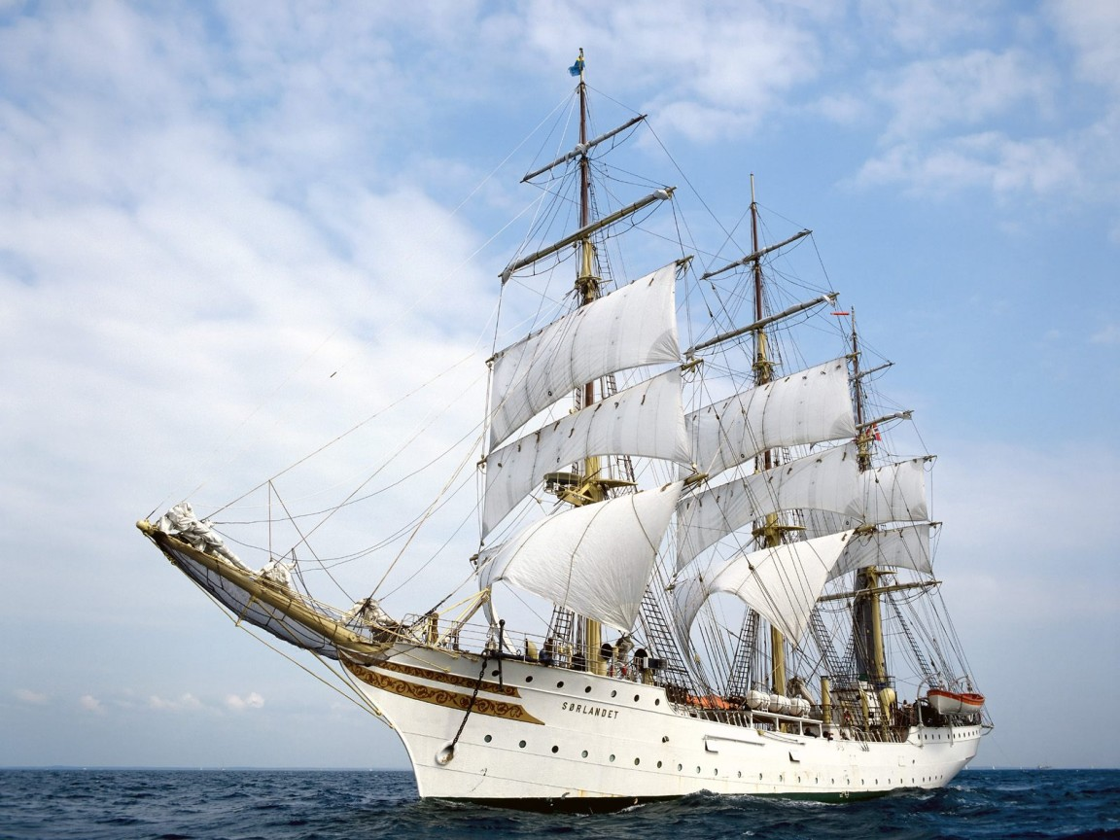
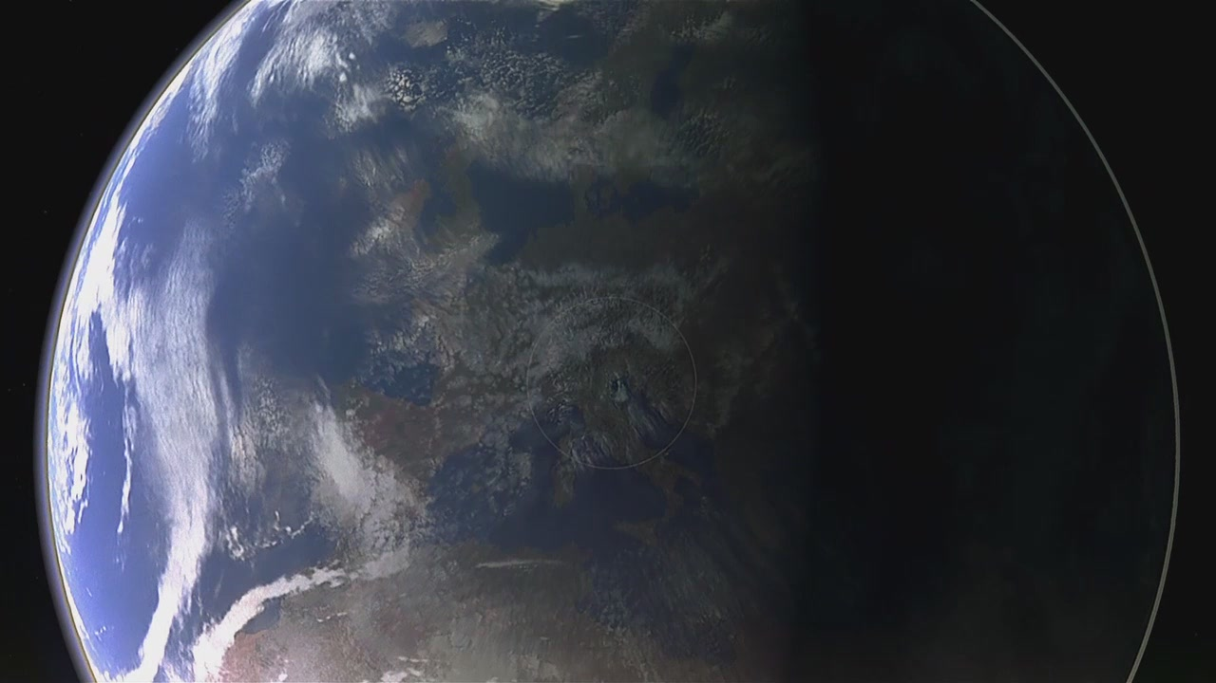
Bon voyage!
voyage

Slide 8

Forgot anything
?
shampoo & conditioner
sun block lotion
pajamas
razor (shaving blades)
cell phone charger
cash

Slide 9

Package tour VS DIY tour
Travel agency
Peak season

Slide 10
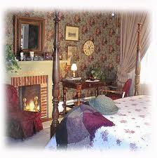
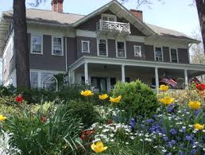
Bed & Breakfast
(a private home which takes in guests)

Slide 11
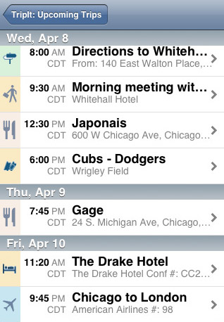
itinerary

Slide 12
Room Service
Souvenir shop
Wake Up Call/Morning Call
Destination of the flight
Departure/arrival times
Discounts for children and frequent fliers
Cancellation charges
Hotel/motel/youth hostel/inn

Slide 13
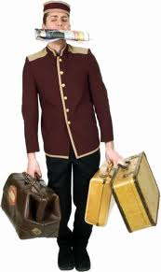
Bellboy
(a staff member who helps guests with their luggage)
Standard guest room/deluxe guest room/suite/guest room with view
Maximum capacity

Slide 14
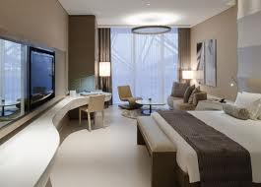
single bed/twin bed 【74 in×37 in （188cm*94 cm）】
double bed/full bed【80 in × 50 in（200 cm×127 cm）】
queen bed【80 in × 60 in （200 cm ×150cm）】
king bed/eastern king【76 in×80 in（192cm×200cm）】
California king/western king
【72 in×84 （184cm×208cm）】

Slide 15

a request to save a specific room for a future date
reservation

Slide 16
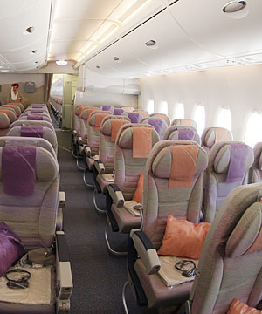
the long empty space that you walk down on an airplane
aisle

Slide 17
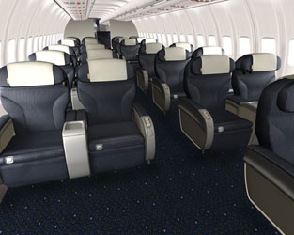
a class of air travel which is less luxurious than first class but more luxurious than economy class
Club class

Slide 18
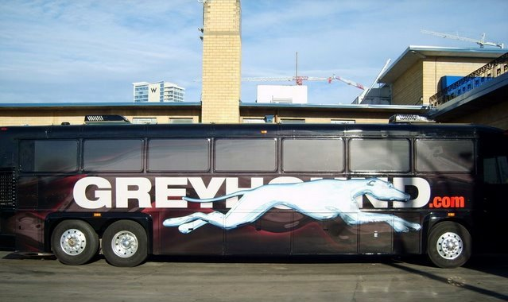
a bus or coach company which provides cheap transport throughout the US
Greyhound

Slide 19
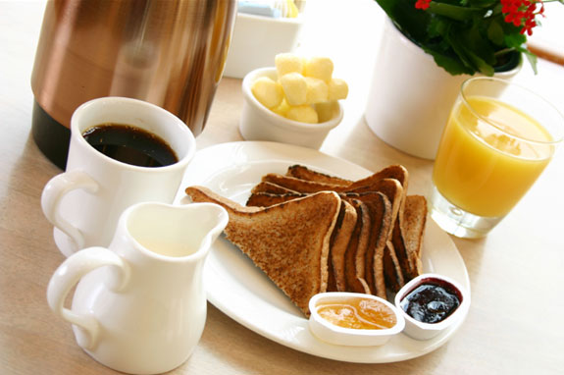
a breakfast which is offered by hotel free of charge
complimentary breakfast

Slide 20
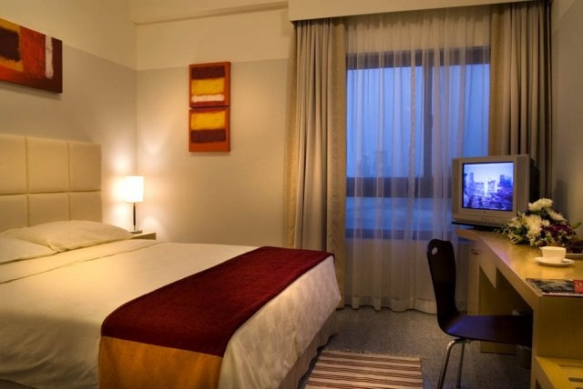
accommodations that are slightly cheaper than hotels
budget hotel

Slide 21
Sentence patterns:
I'd like to make a reservation for a flight to New York on September 15th.
What time does Flight 408 arrive?
How much is airfare?
I'd like to reconfirm my plane reservation please.
我要订9月15号到纽约的班机
408次班机何时抵达？
机票多少钱？
我想要确认我预订的机位。

Slide 22
boarding pass
excess baggage
stopover
Aisle
jet lag
baggage claim
special ticket showing that passenger has checked in and may board plane
luggage that is more than the permitted or allowed weight
a break for a day or two on an international flight
corridor in aeroplane between the seats
extreme tiredness etc after a long flight between extreme time zones
place where passengers go to find their luggage (cases etc) at the end of a flight

Slide 23
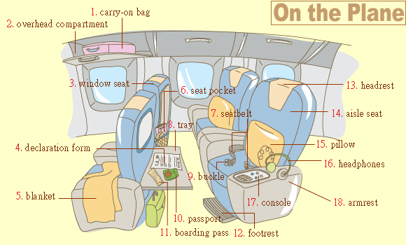

Slide 24

international airport
domestic airport
airport terminal
international terminal
arrivals
departures
nothing to declare
customs
gate; departure gate
国际机场
国内机场
机场候机楼
国际候机楼
进站(进港、到达)
出站(出港、离开)
不需报关
海关
登机口

Slide 25
departure lounge
FLT No (flight number)
arriving from
scheduled time (SCHED)
landed
departure to
departure time
delayed
boarding
stairs and lifts to departures
候机室
航班号
来自......
预计时间
已降落
前往......
起飞时间
延误
登机
由此乘电梯前往登机

Slide 26
Where may I check in for United flight number 706?
What time will boarding start?
I'm connecting with AF123.
Where can I get information on a connecting flight?
我该到哪里办联合航空706次班机登机手续?
什么时候开始登机？
我要转法国航空123号班机。
哪里可以询问转接班机的事情？

Slide 27


airline announcements:
Pre-boarding Announcement
Final Boarding Announcement
Pre-flight Announcement
Captain's Announcement
Safety Briefing

Slide 28
Expressions
Tour Guide
In front of you is...
On your right/left you will see...
Up ahead...
As we turn the corner here, you will see...
In the distance...
Off to the north...
In a few minutes we'll be passing...
We are now coming up to...
I'd like to point out...
Keep your eyes open for...
Tourist Questions
Is that the...you were talking about?
Are we going to pass the...?
Are we going to see any...?
Is it on the right or the left?
I don't see it. Can you point it out again?
Did I miss it?
Will we see it on the way back?

